Slide 1
Adapting to climate-induced food price shocks in the UK
“Climateflation”
This work was supported by UK Research and Innovation (UKRI) Building a Green Future strategic theme [Project number 49522] as part of the Maximising UK Adaptation to Climate Change (MACC) programme co-designed UKRI, Defra, the Met Office and the UK Government’s Climate Change Committee.

Slide 2
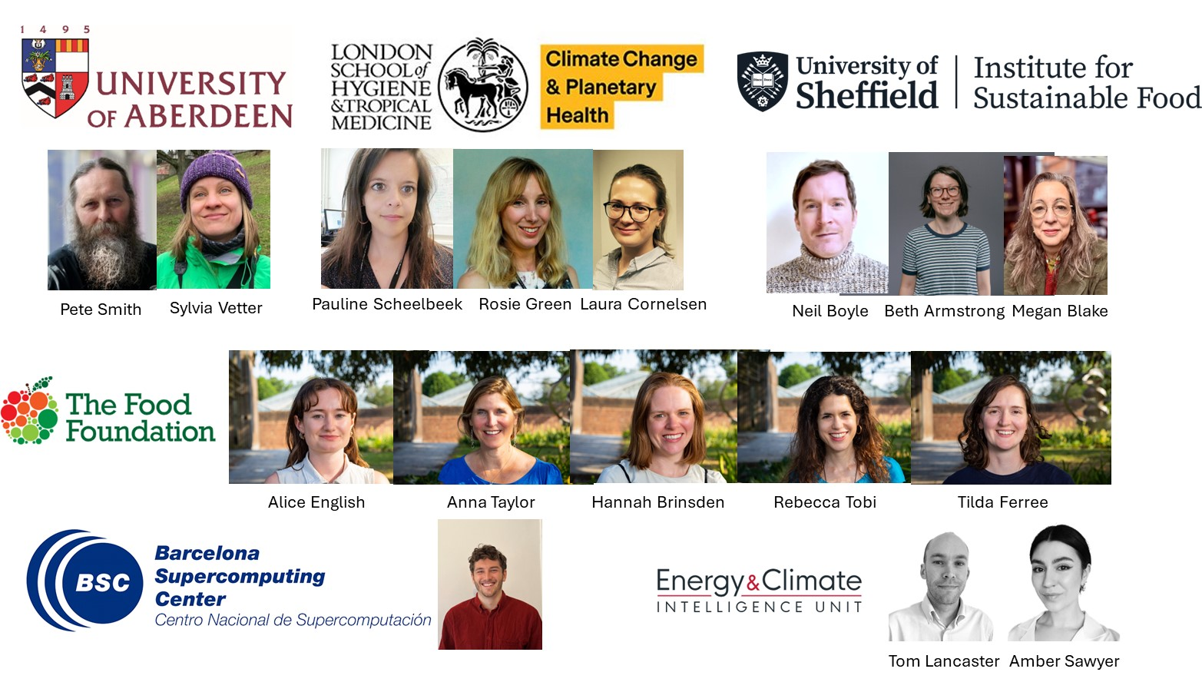
Max Kotz

Slide 4
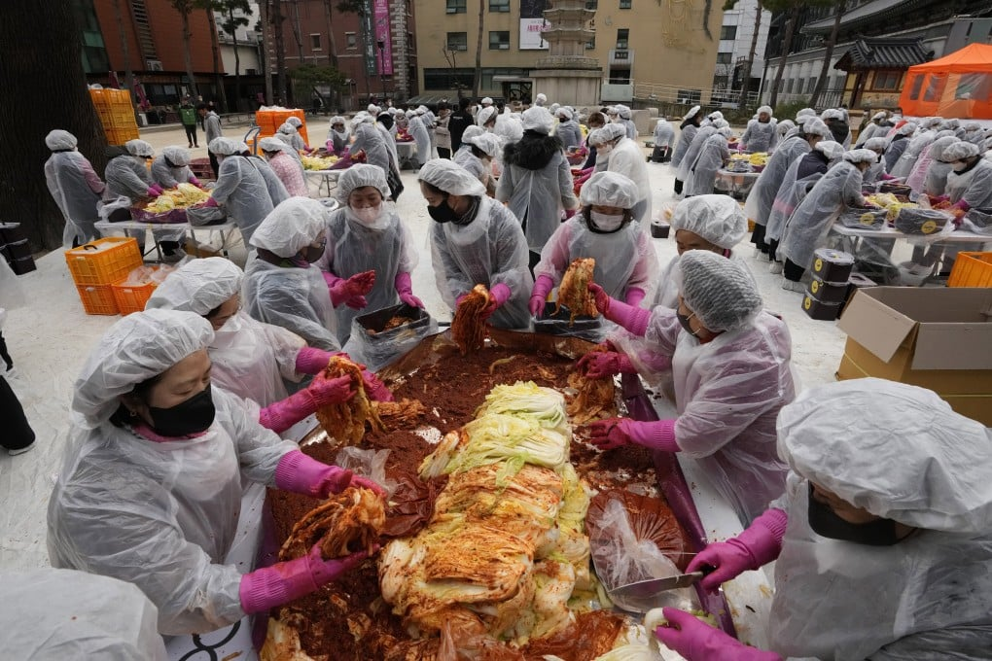
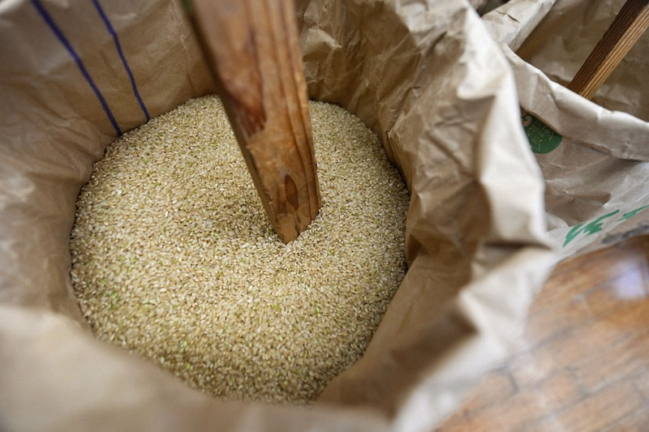
Climate change impacts on food prices
Climate extremes can impact crop productivity and food prices:
Korea: Kimchi
Japan: Rice
Italy/Spain: Olive oil
70% increase from 2024 heatwave
https://www.scmp.com/news/asia/east-asia/article/3279341/too-hot-handle-south-korean-kimchi-under-pressure-heatwave-drives-cabbage-prices
41% increase from 2024 heatwave
https://mainichi.jp/english/articles/20241019/p2g/00m/0bu/004000c#:~:text=TOKYO%20(Kyodo)%20%2D%2D%20The%20price,farm%20ministry's%20data%20showed%20Friday.
50% increase from 2022/23 drought
https://www.carbonbrief.org/five-charts-how-climate-change-is-driving-up-food-prices-around-the-world/

Slide 5
Climate change impacts on food prices
Prior work:
- Data-driven approach to identify how climate extremes impacts food prices.
- Monthly data from 121 countries, past 30 years.
Non-linear, persistent impacts of temperatures on food prices.
Projected future pressures under climate change scenarios
Kotz, Maximilian, et al. "Global warming and heat extremes to enhance inflationary pressures." Communications Earth & Environment 5.1 (2024).

Slide 6
